Slide 1

DAY 2
HANDS - ON

Slide 2
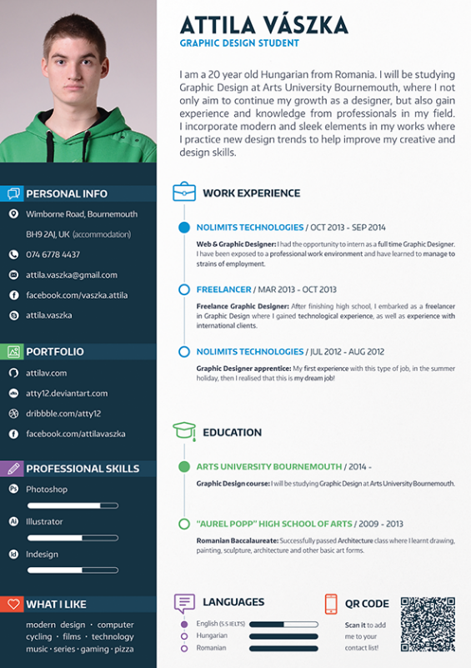
GEN AI
resume
screener
This Photo by Unknown Author is licensed under CC BY-NC-ND

Slide 3
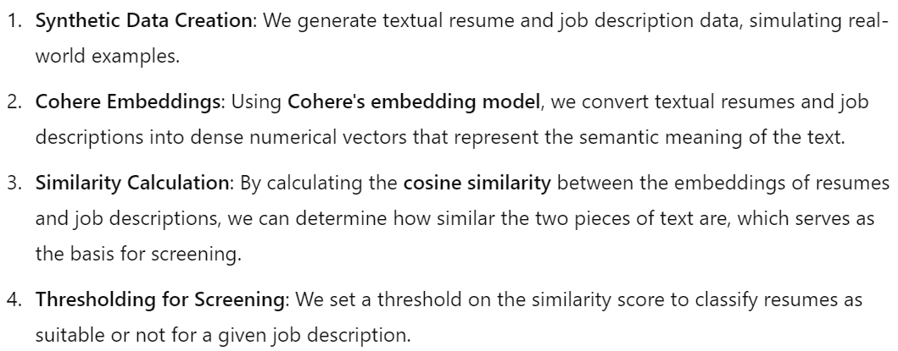
COHERE BASED RESUME SCREENER

Slide 4
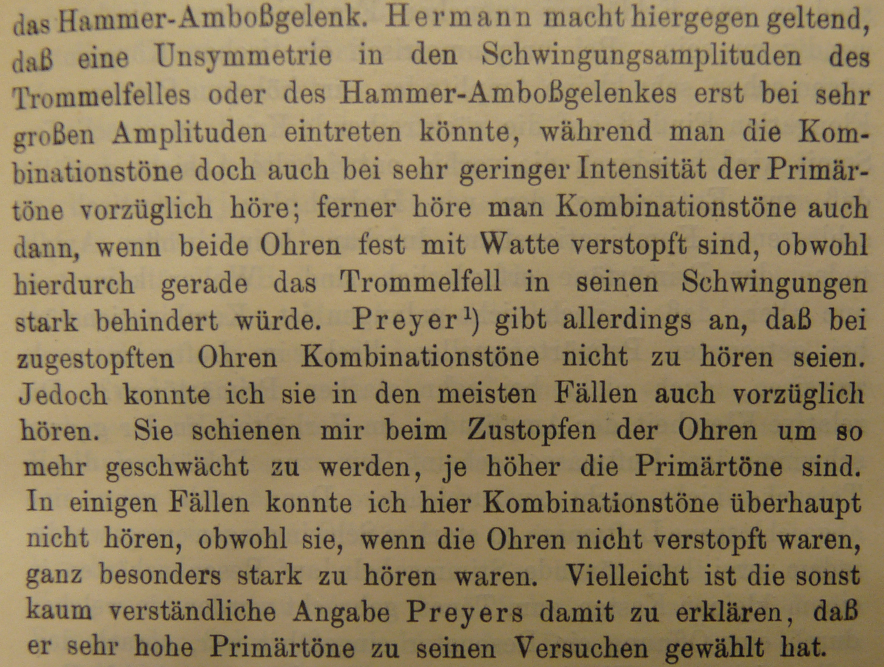
GEN AI
SUMMARIZATION
MODULE

Slide 5
EXTRACTIVE
SUMMARIZATION

Slide 6
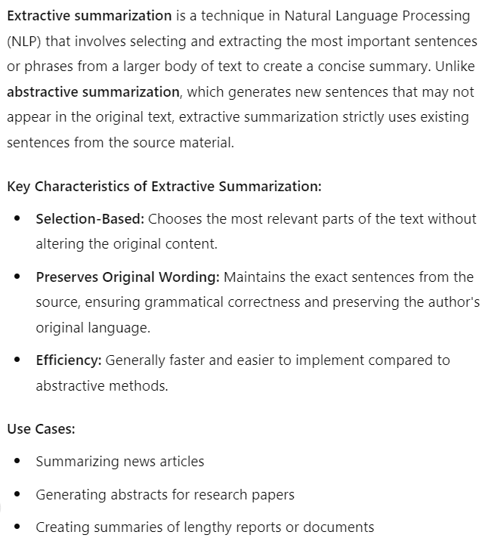
EXTRACTIVE SUMMARIZATION

Slide 7
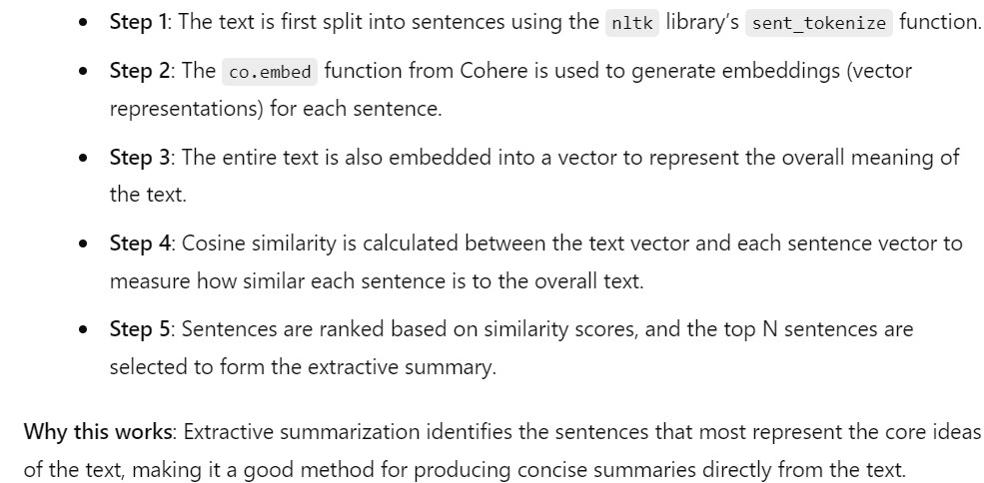
EXTRACTIVE SUMMARIZATION

Slide 8
Abstractive
SUMMARIZATION

Slide 9
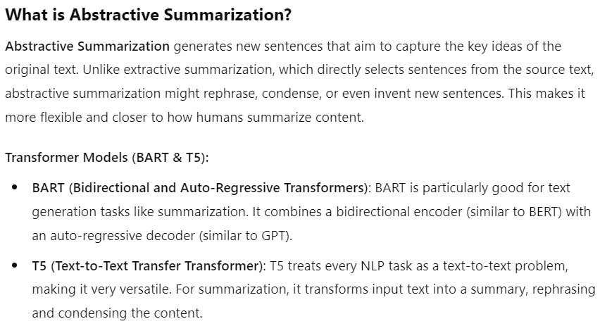
ABSTRACTIVE SUMMARIZATION

Slide 10
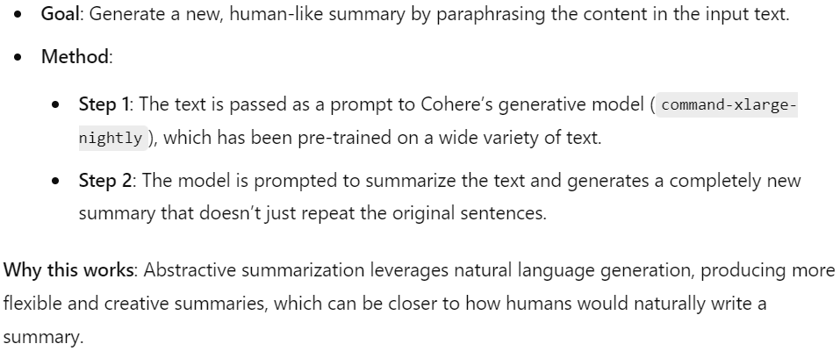
ABSTRACTIVE SUMMARIZATION

Slide 11
HYBRID
SUMMARIZATION

Slide 12
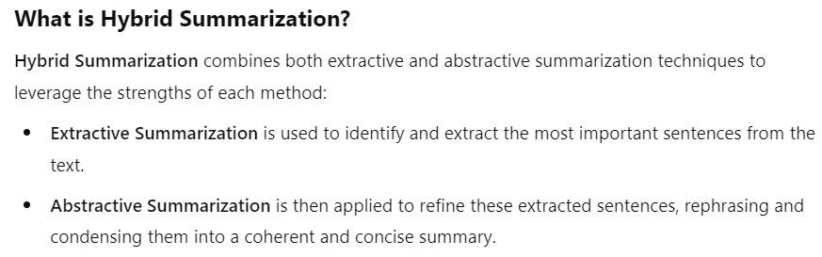
HYBRID SUMMARIZATION

Slide 13
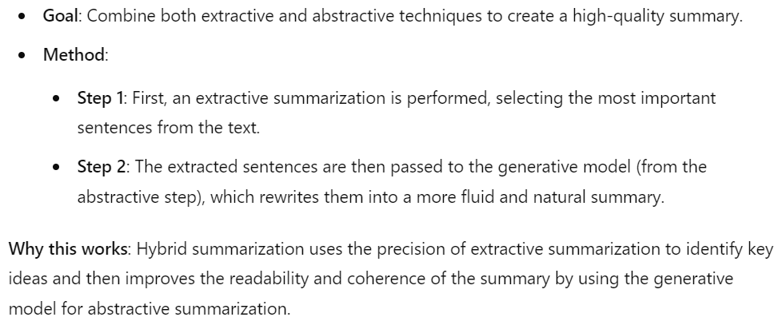
HYBRID SUMMARIZATION

Slide 14

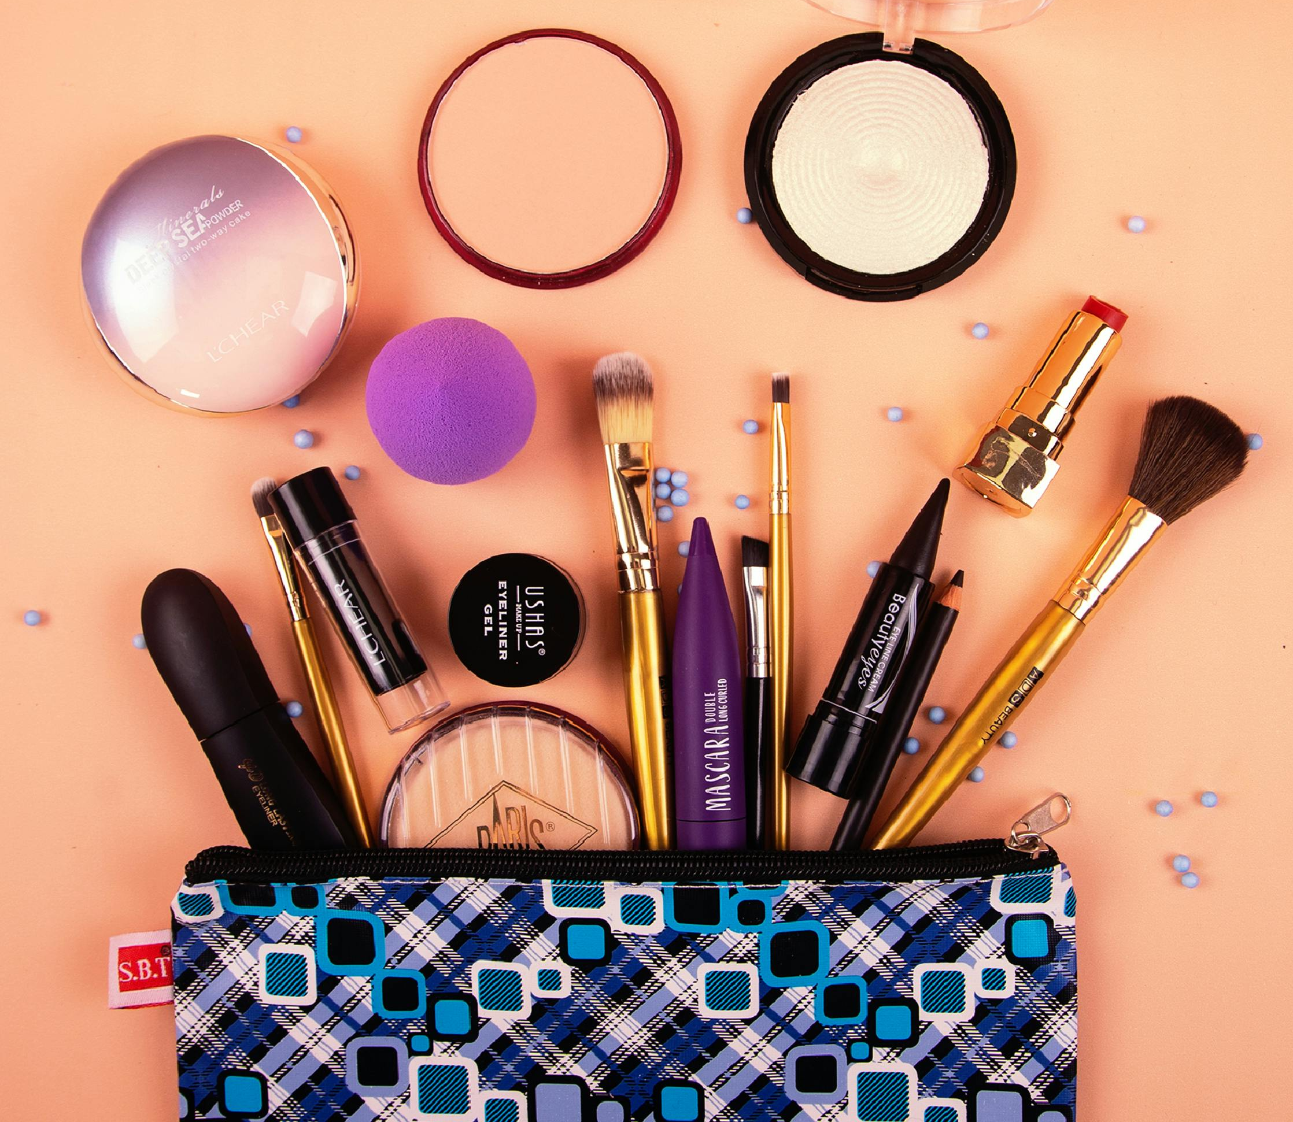
Generic
Recommendation
engine

Slide 15
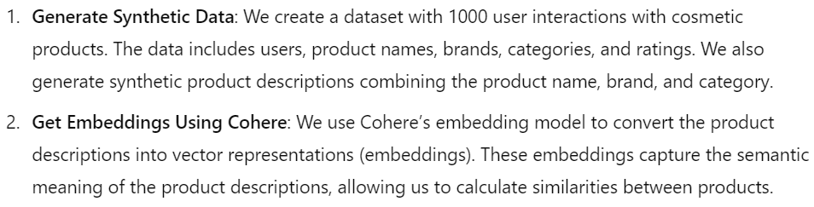
DATA GENERATION & EMBEDDINGS GENERATION

Slide 16
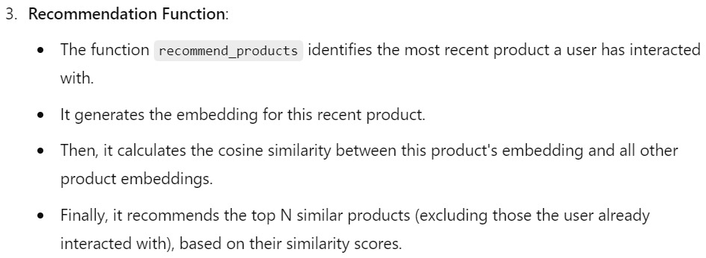
RECOMMENDATION ENGINE

